Slide 1


Linear Programming Project: Optimizing responses to arson calls by the Denver Metro Fire Police Department
By: Sandra Robles Muñoz & Elizabeth Hope Haygood
Fall 2020

Slide 2
High-level Question
Can we look at fires in Denver County for the last 5 years and determine which Fire Station needs to respond to it?
Would this mean that stations should answer calls outside of their district?

Slide 3
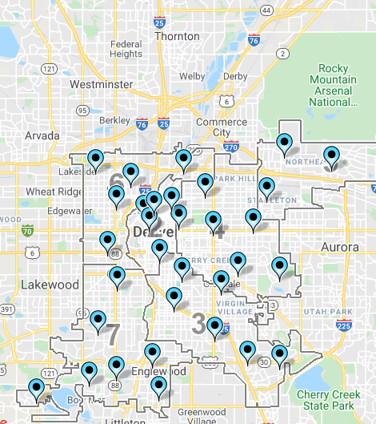

Data
Using Crime data for the County of Denver https://www.denvergov.org/opendata/dataset/city-and-county-of-denver-crime
Over 600 fires in the last 5 years.
Categories of fires: vehicles, residence, business, public building, ‘other’.
There are 40 fire stations in the County of Denver
https://www.denvergov.org/opendata/dataset/city-and-county-of-denver-fire-stations
They’re assigned to “districts” (left)
Image Source: denvergov.org’s Fire Department website

Slide 4
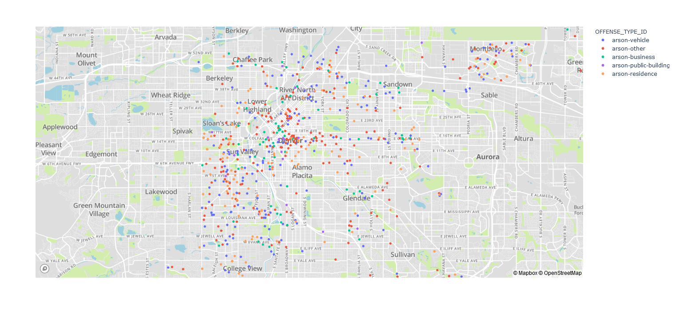
The data, continued

Slide 5
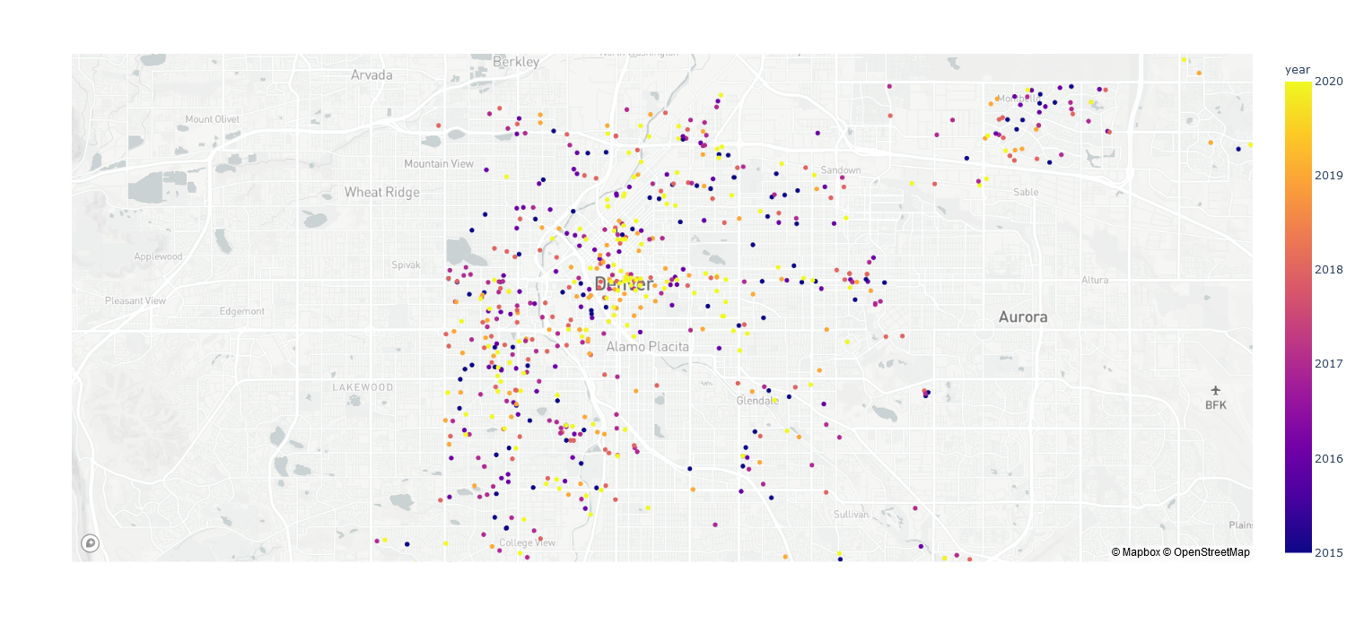
The data, continued

Slide 6

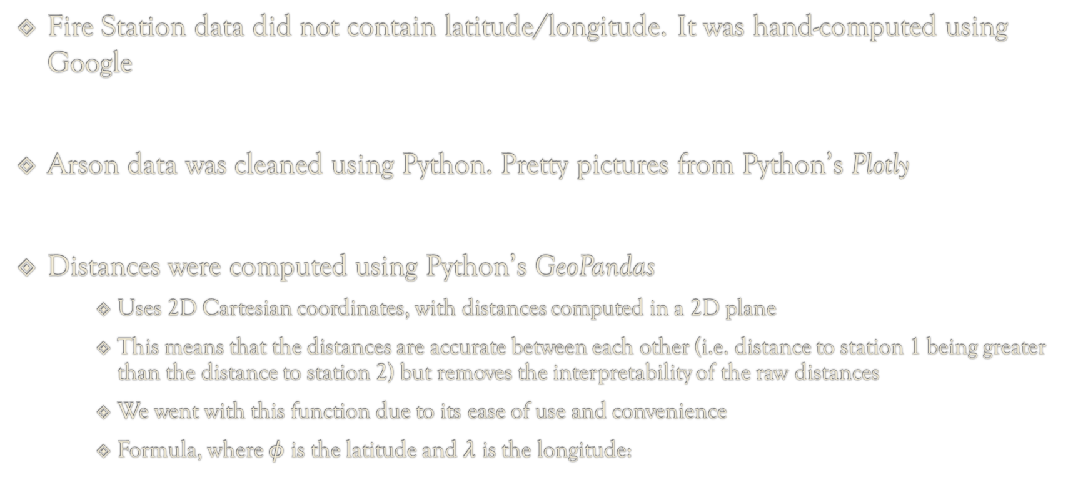
The Data, continued
Fire Station data did not contain latitude/longitude. It was hand-computed using Google
Arson data was cleaned using Python. Pretty pictures from Python’s Plotly
Distances were computed using Python’s GeoPandas
Uses 2D Cartesian coordinates, with distances computed in a 2D plane
This means that the distances are accurate between each other (i.e. distance to station 1 being greater than the distance to station 2) but removes the interpretability of the raw distances
We went with this function due to its ease of use and convenience
Formula, where $φ$ is the latitude and $λ$ is the longitude:

Slide 7
Linear Program
The location of each arson will be derived, and the distance of each arson to each fire station will be computed (Previous slide)
We will determine which fire station should respond to each arson fire in such a pattern that minimizes the distances
This would be an assignment problem
The assignment problem is unbalanced with more tasks (arsons) than fire stations
i.e. if a neighborhood has more arson than the others, we could allocate funds to build a fire station within the cluster

Slide 8

Linear Program, continued
Linear Program:
$$\min\left(\sum_{iεn}{\sum_{jεm}{c_{ij}x_{ij}}}\right)$$
$$\sum_{i ε n}{x_{ij}=1 }∀ i ε n$$
$$x_{ij} ε \{0,1\}$$
Carried out using Python’s SciPy implementation of LP, ‘linear_sum_assignment’
Does not have a built-in constraint for a squared cost matrix

Slide 9
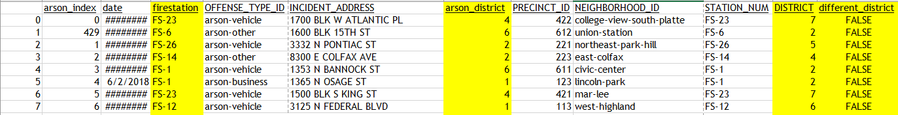
Optimized Output
Each row is a fire reported over the last 5 years
Column ‘arson_district’ is the district in which the fire occurred
Column ‘firestation’ is which station in which the Linear Program recommends to respond to the fire
Column ‘District’ is the district of the fire station that the Linear Program says should respond
Column ‘different_district’ triggers FALSE if the responding fire station is outside of the district in which the fire occurred
Triggers TRUE if the responding fire station is inside the district in which the fire occurred
78% of arsons have a responding fire station outside of its own district

Slide 10
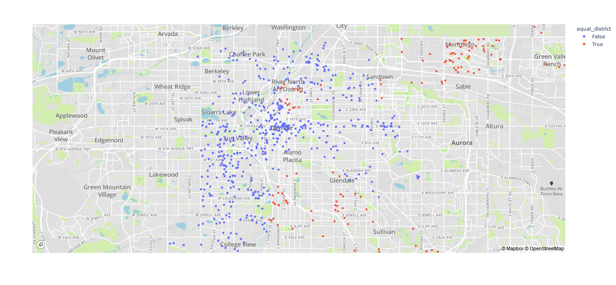
Visualizing the results

Slide 11
Policy Ideas Obtained from Linear Program
We can see that there are a substantial number of fire stations that are responding to fires that are not within their district
We can make the valid argument that there is a need to advocate for funding to build more fire stations within the Denver-Metro Area
For future work we could take a closer look at which district is in the most need of another fire station

